Slide 1
Jnana Prabodhini, Nigdi Biotechnology Division Research and Extension

Slide 2
Details of Projects
2005-08 : Community Training and Demonstration in Sustainable Agriculture : Department of Biotechnology , New Delhi.
2008-14 : Stevia Research :
1. Department of Science and Technology, New Delhi .
2. Sun Fruits Ltd. Pune.
2016 : Capacity Building Program for 10 villages for women Self Help Groups Sponsored by National Medicinal Plant Board , New Delhi and , Maharashtra State Horticulture and Medicinal Plant Board, Pune.
2017 : Special Course Development for Ayurveda Students on Conservation and Cultivation Of Medicinal Plants using Plant Tissue Culture Techniques.
2018-19 : Creation of an Arboretum : Resource Mapping at Salungan , Bhor.
2019 : Bamboo Tissue Culture : Joint Project with Kala Biotech

Slide 3
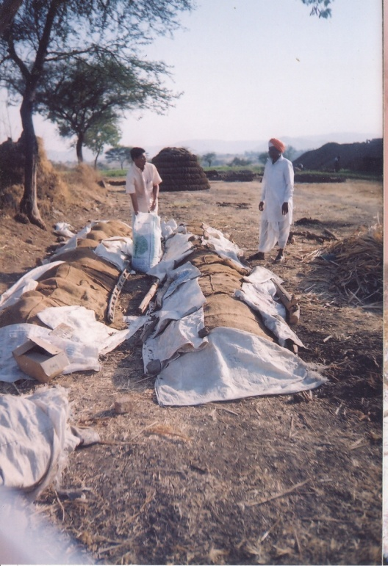
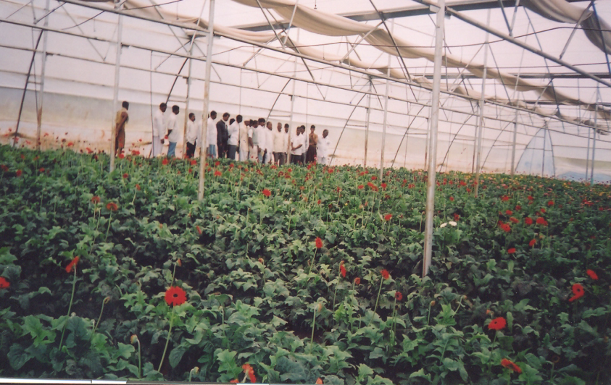
Integrated Rural Community Program of Demonstration and Training in Sustainable Agriculture
Duration :2005-2008 , Supported by
Department of Biotechnology , New Delhi,

Slide 4
Account of Participation In Programme
Sr. No. | Activity | Year I | Year II | Year III | Total
1 | Training Programmes | 1151 | 1619 | 809 | 3579
2 | Demonstration | 89 | 102 | 80 | 271
3 | Rallies | 553 | 433 | 768 | 1754
4 | Exposure Visits | 132 | 44 | 96 | 272
 | Total | 1925 | 2198 | 1753 | 5876

Slide 5
Achievements : Income generating activities Stared
Sr. No. | Activity | Units | Nature of Activity
1 | Poly houses | 35 | Commercial | activity
2 | Vermicompost units | 30 | Domestic | Use
 |  | 7 | Commercial | activity
3 | Azolla Production | 16 | Domestic | use
4 | Mineral mixture Sale | 1 | Commercial | activity

Slide 6
Present Need – Future Demand : Stevia
India – Largest Consumer of Sugar
Synthetic substitutes of sugar
India – Largest Diabetic Population
Demerits of Sugarcane Cultivation:
Pollution of Environment
Demerit: Side Effects
Need for low calorie food sweetener, with no side effects
Ideal Replacement for Sugar
Notes:
Prevalence of life style diseases
Diabetes,obesity,dental caries
Demerits of synthetic/artificial sweeteners
Negative effects on the liver, kidneys and other organs
Stimulating cravings
Gastrointestinal disorders
Headaches
Changed Life Style
Health conscious customers
Increasing Demand for low calorie foods

Slide 7
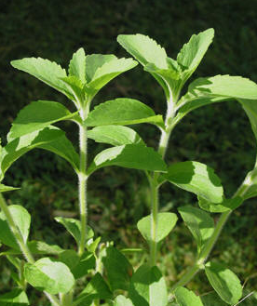
Research in Natural Sweetener : Stevia
Stevia : Incredible Natural Sweetener
2008- 12 : Research in Extraction and Product Development, Supported By Women Scientist Fellowship , DST, New Delhi.
2011 - 13 : Protocol Development for Tissue Culture,
Supported By Sun Fruits , Pune.
2013 - 15 : Use of Protocol for Commercial scale production of Stevia for
Sun Fruits , Pune.
Notes:
Unknown and unseen plant people were not ready to believe
FDA status : 1. permission for cultivation few people were arrested.
NMPB and Horti subsidy,
dietary use status was not clear, in puts to the officers
Permission for use and testing, ethno botanical use for more than 1000 yrs,
HBT working for 10 yrs.
Artificial sweetener, use in formulations
Tissue culture : 6 months no results patience
Road preparation in unknown teretory
All capacities are used : physical inte social and skills
New opp ; challenge , illiterate to DBT other scientists wide range

Slide 8
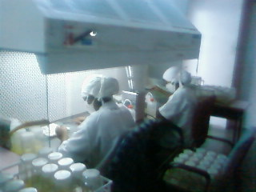
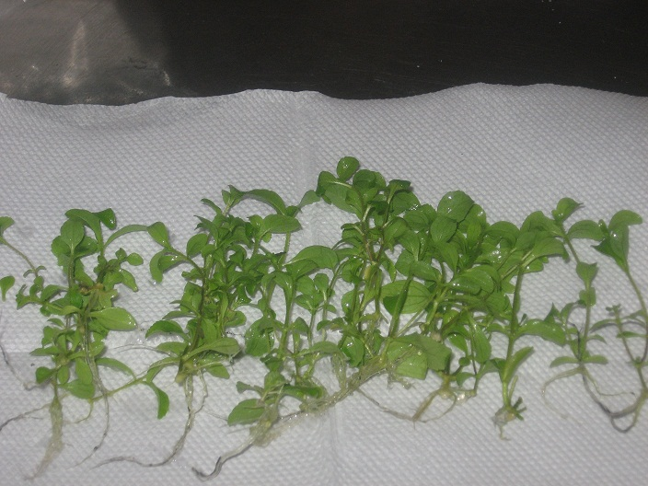
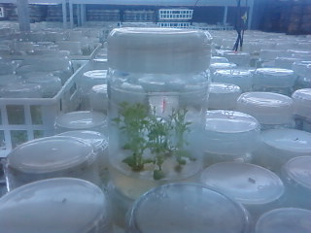
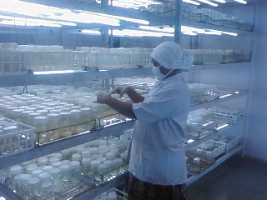
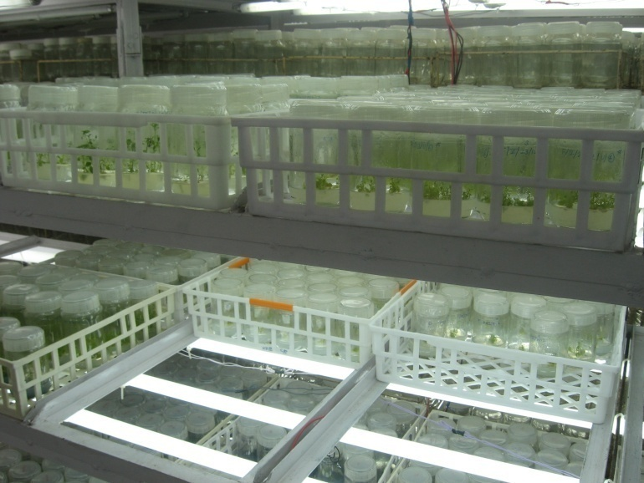
Stevia : Tissue Culture

Slide 9
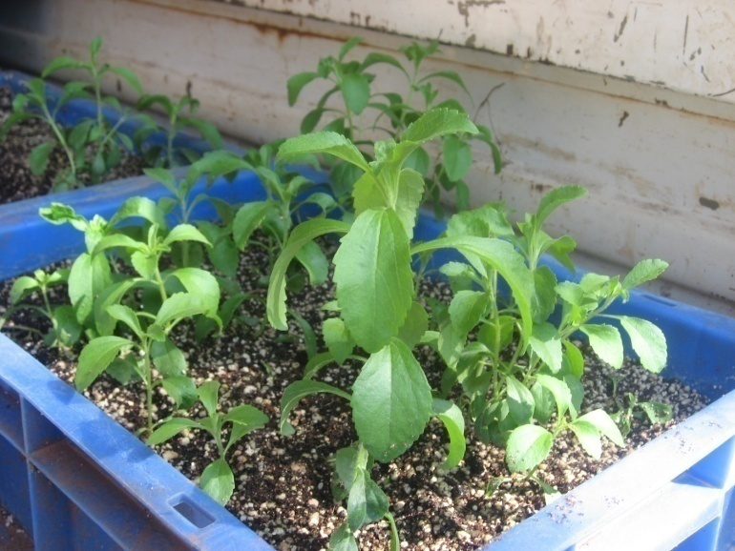
Stevia : Tissue Culture

Slide 10
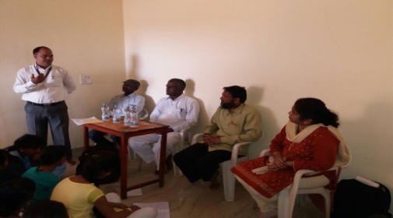
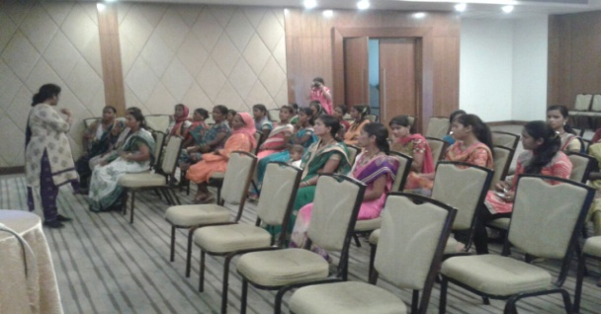
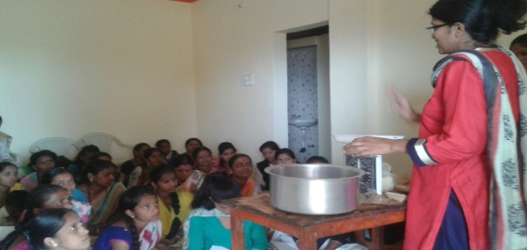
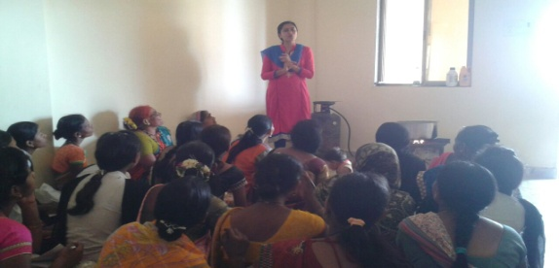
Capacity Building Program for Women Self Groups Supported by National Medicinal Plant Board, Delhi. ( 2017)

Slide 11
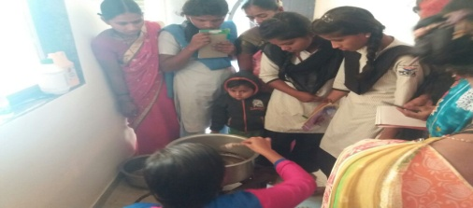
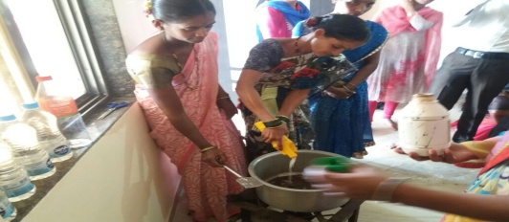
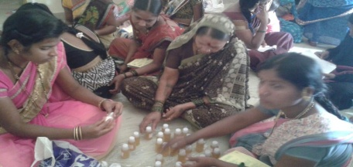
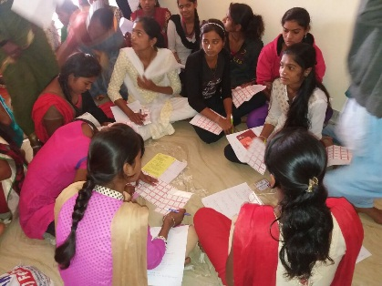
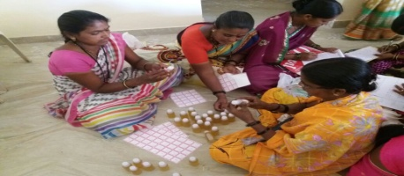
Training Of Participants

Slide 12
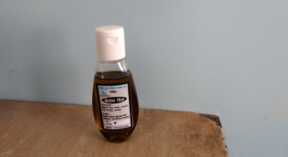
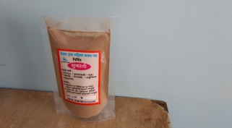
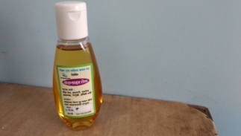
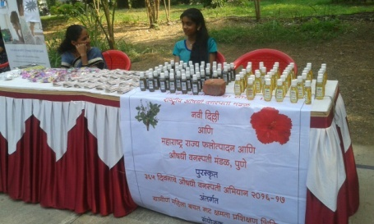
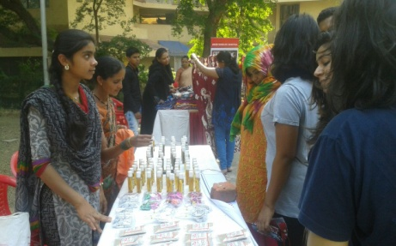
Participation in Exhibition
Products developed during
training
Products developed for sale

Slide 13
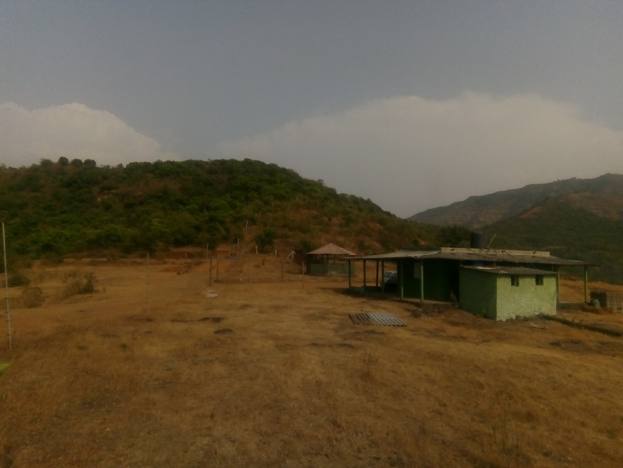
Creation of Arboretum In situ conservation of Medicinal Plants and Bamboo cultivation at Salungan,Bhor. (2018-19)
Surveys were conducted for resource mapping in the project area. Prepared a detailed plan for creation of an arboretum .Identified 12 plants which need conservation.

Slide 14
Projects of College Students
Our department started and designed course for Ayurveda students named “ Conservation and Cultivation Of Medicinal Plants using Plant Tissue Culture Techniques.” in 2018.
Two students of Ayurveda completed project on “ Micro propagation of Rubia cordifolia” using axillary bud and leaves for accomplishment of master’s degree.
A Student of Ramakrishna More College, Nigdi completed her project, “ In Vitro Multiplication of Curcuma longa (Lakadong) variety having high curcumin content” for master’s Degree.

Slide 15
On Going Work
Protocol Development for Medicinal and ornamental plants
Protocol Development for endemic bamboos
Extension Efforts in Bamboo Cultivation and Processing

Slide 16
Protocol Development
Medicinal Plants :
Stevia, Bacopa monerii ,Piper longum ,Curcuma longa ,Aloe vera
Zingiber officinale
Ornamental Plants :
Green Xanado, Golden Xanado,Spathiphyllum, Cordiline, Marble Money Plant, Philodendron Ceylon

Slide 17
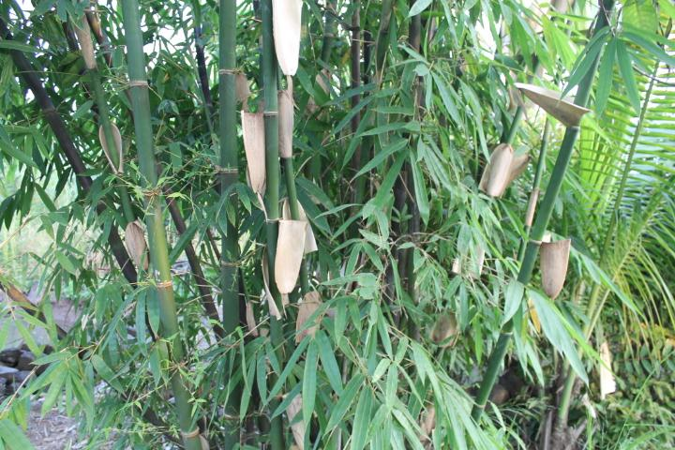

Slide 18
Progress in Bamboo Tissue Culture
2014 -2015 : Protocol development of Bambusa Balcooa
2016 -2018 : Protocol Standardization of Dendrocalamus brandasii, Dendrocalamus asper, Bambusa tulda .
2019 : Protocol Standardization of Dendrocalamus stocksii, Dendrocalamus strictus.
2019 : Joint Project with Kala Biotech for commercial scale production.

Slide 19
Bamboo : Cultivation
Neelambar Vruksh Prabodhini Premises :
Cultivation of three Bamboo varieties: Balcooa,Tulda and Manga
Farmers’ Trainings Sheti Shalas at Bhor and Velhe Min. 50 Farmers
Advocacy: To a group of farmers at Velhe, Bhor

Slide 20
FARM SCHOOL’S at Bhor : June 2018

