Slide 1
Observation of Bamboo Clums

Slide 2
Mayor of Pune Mr.Murlidhar Mohol Visit Bamboo Stall

Slide 3
Bamboo Nursery Training by Mr.Sagar Tupe in Jaytpad,Tal-Bhor Dist-Pune

Slide 4
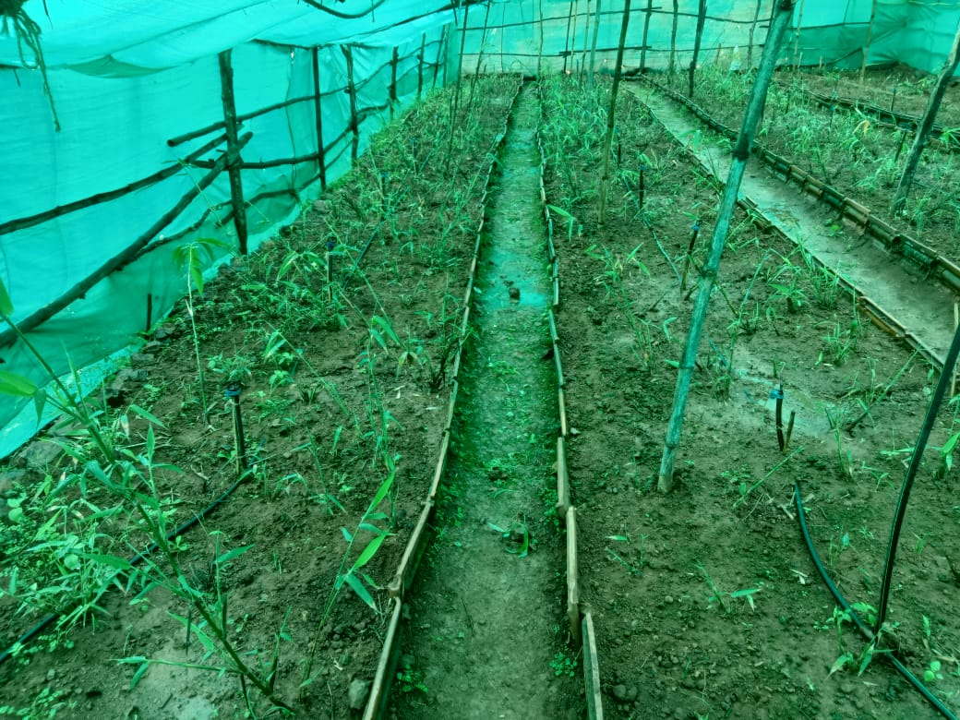
Demonstration Of Bamboo Nursery at Mr.Shreeram Ghadge`s Field

Slide 5
Advisory Visit to Nursery of Ananta Nivangune At/Post-Pole Tal-Velha Dist-Pune

Slide 6
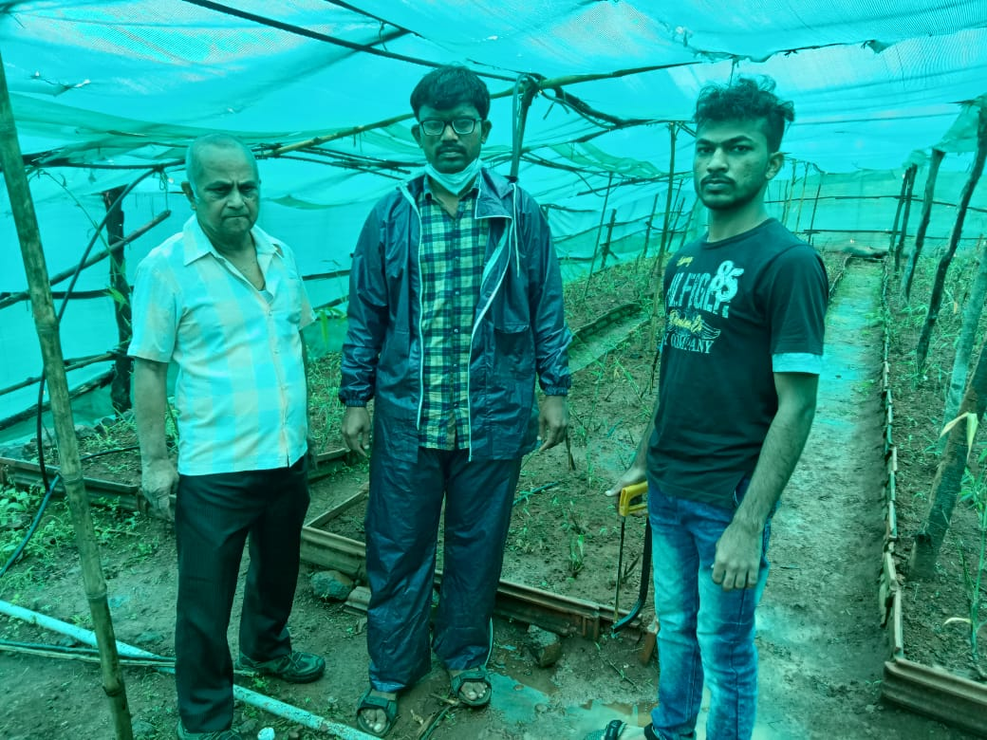
Moinitaring Nursery Visit to Mr. Shreeram Ghadge Field At/Post-Jaytpad Tal-Bhor Dist-Pune

Slide 7
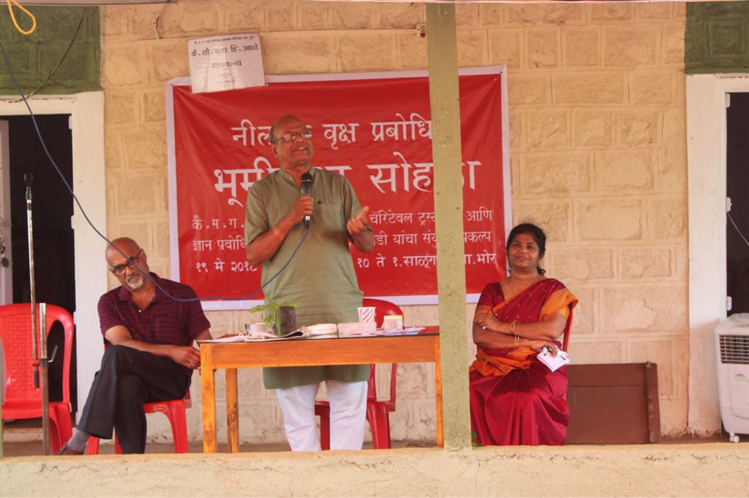
Bhumipuja For Creation Arboretum in Salungaon Tal-Bhor Dist-Pune

Slide 8
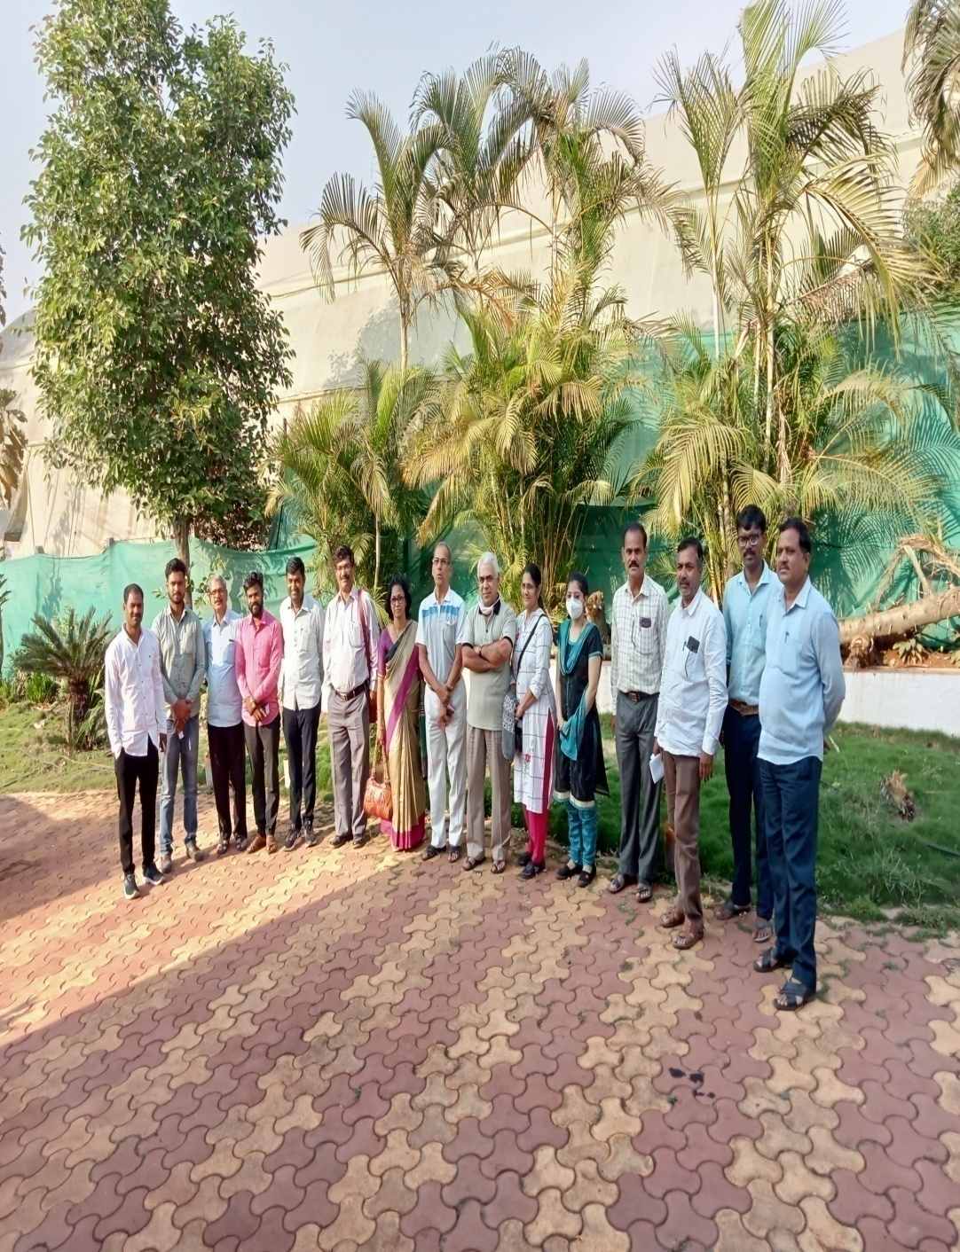
Training Farmers From Maval Block in Bamboo Cultivation

Slide 9
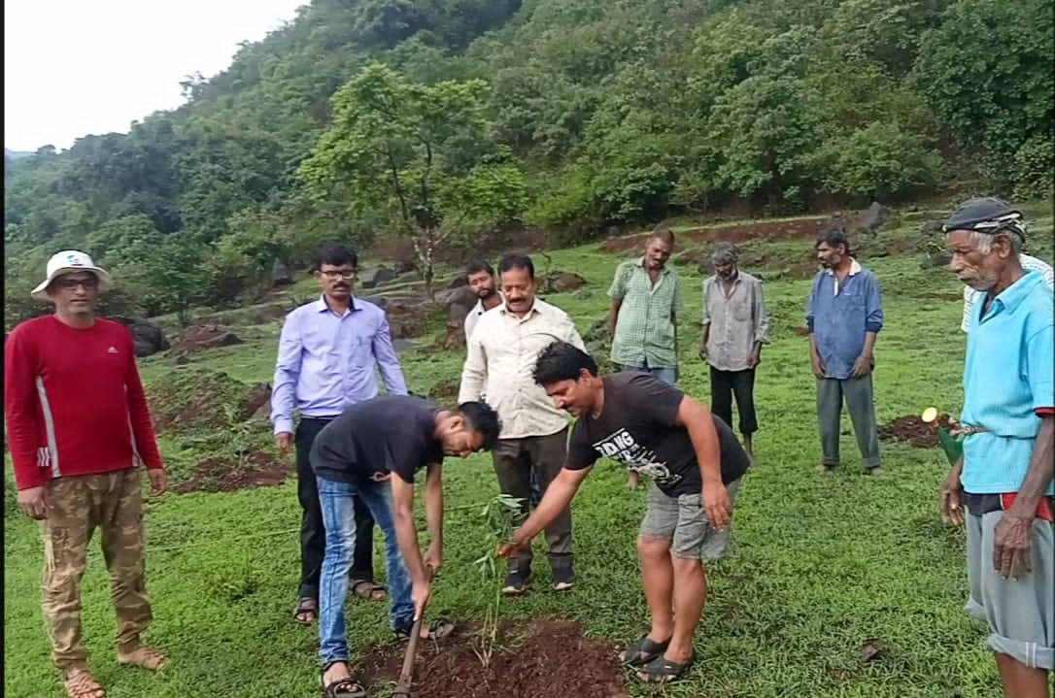
Participation in Opening Ceremony Programme of Bamboo Plantation in Velha Block Conducted by India Bamboo Forum

Slide 10
Dr.Taitali Sir,Dr.E Murlidharan & Dr.Vidhya Visit

Slide 11
Participation in Exhibition by Bamboo Society of India

Slide 12
Secretary of Jnana Prabodhini, Mr.Subhashrao Deshpande Visit

Slide 13
ATMA & Jnana Prabodhini Joint Training Programme For Farmer in Salugaon Tal-Bhor Dist-Pune

Slide 14
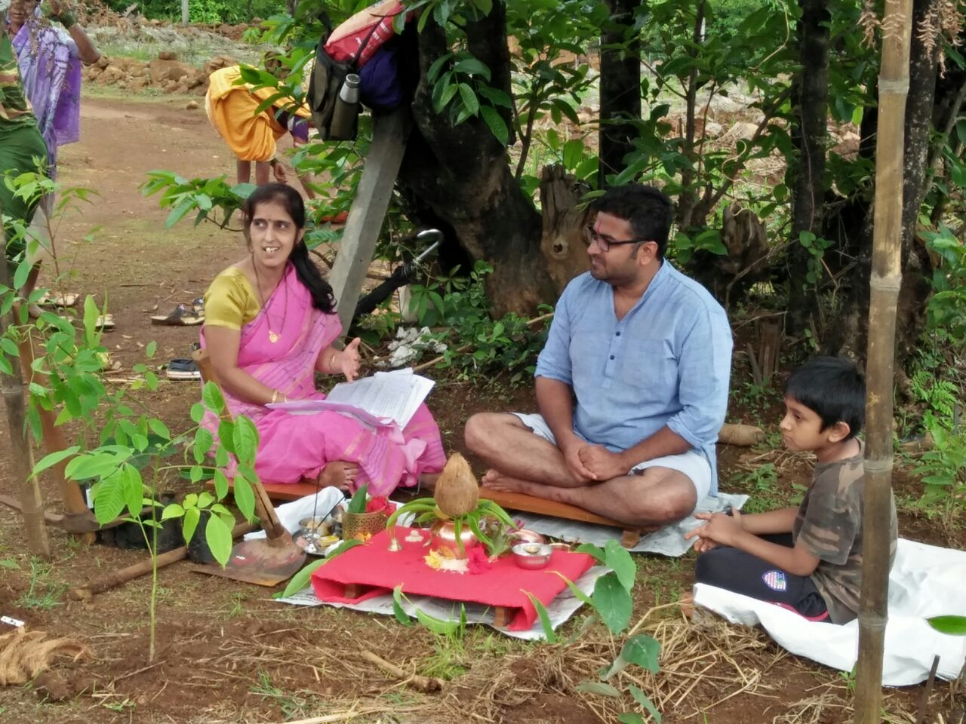
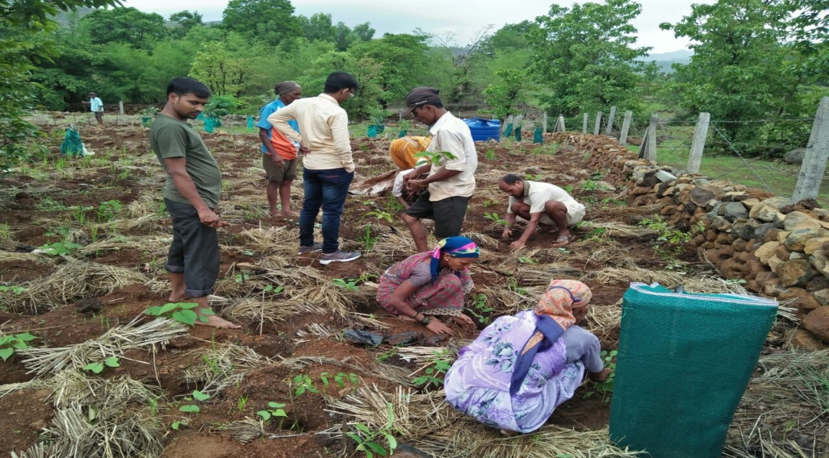
Bhumipuja of Devarai (Sacred Groove) in Kalamb Tal-Velha Dist-Pune

Slide 15
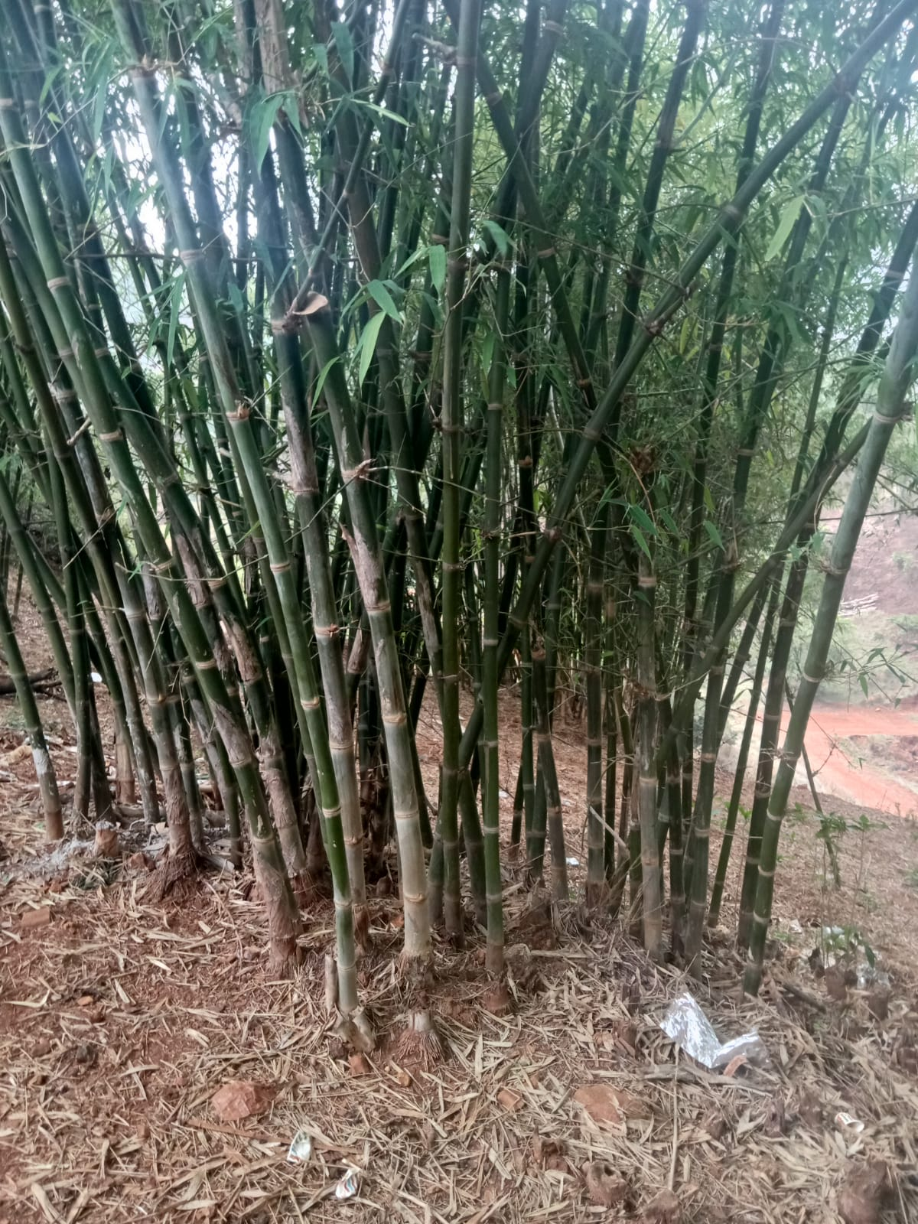
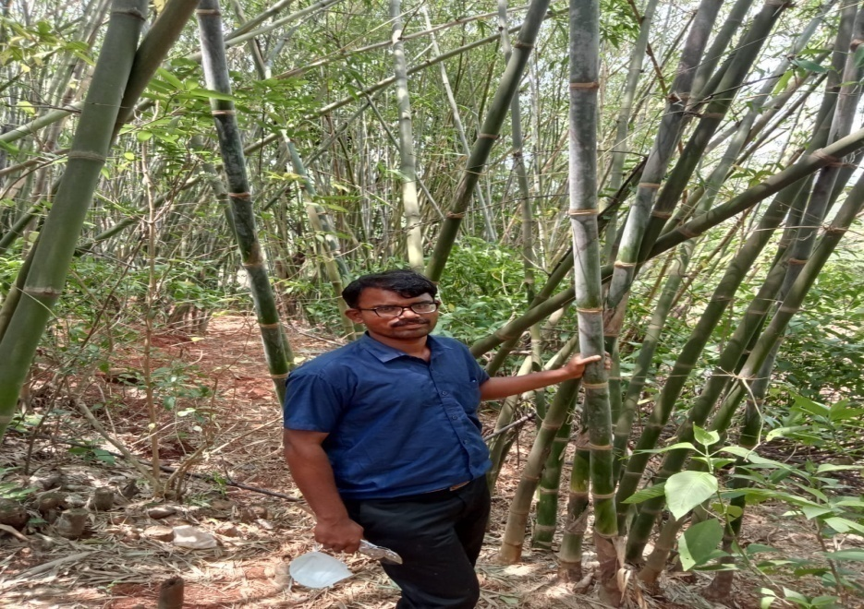
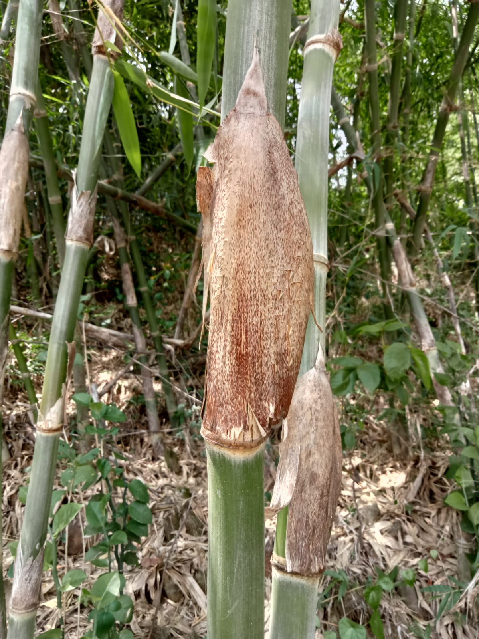
Explant Collection Mess Bamboo (Pseudoxytenanthera madhavi) Buds Collection Mangaon Tal-Velha Dist-Pune

Slide 16
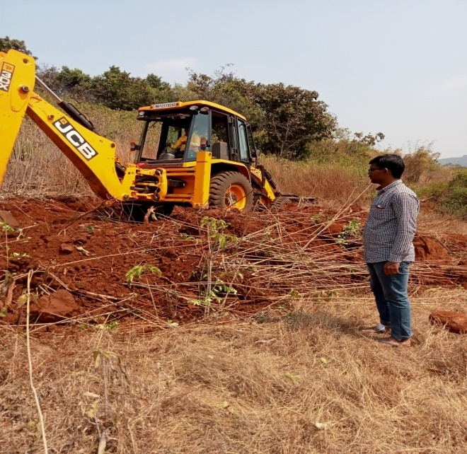
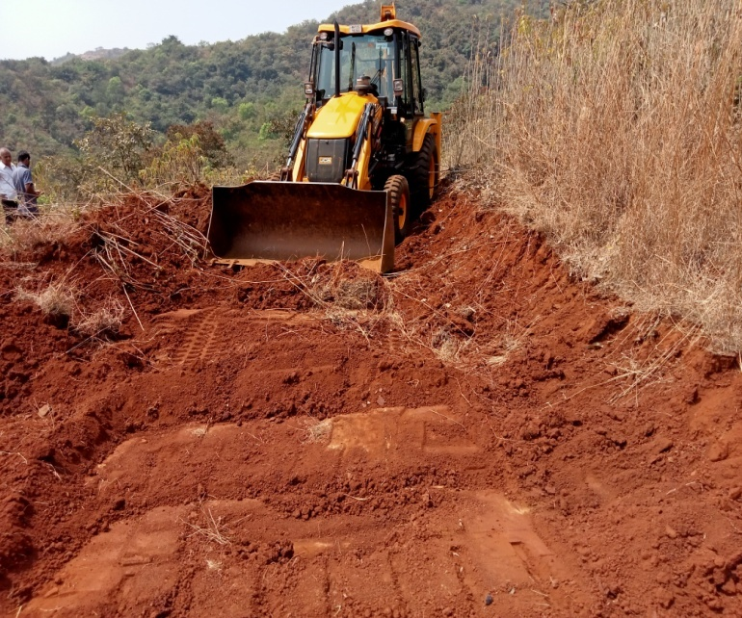
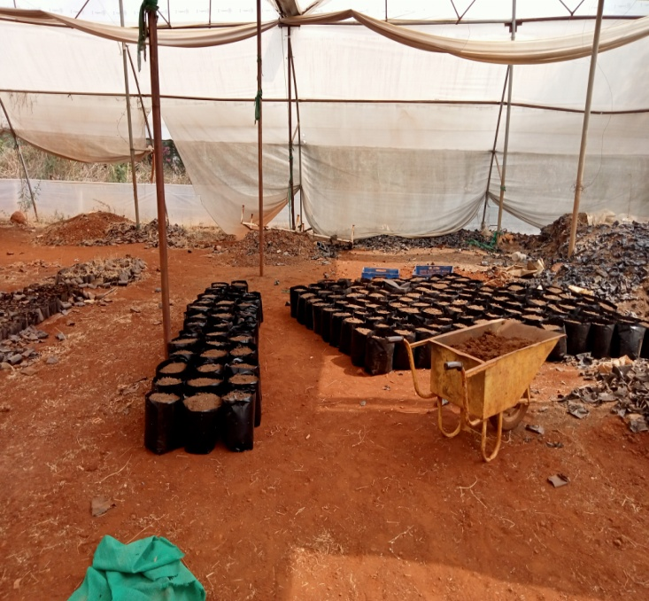
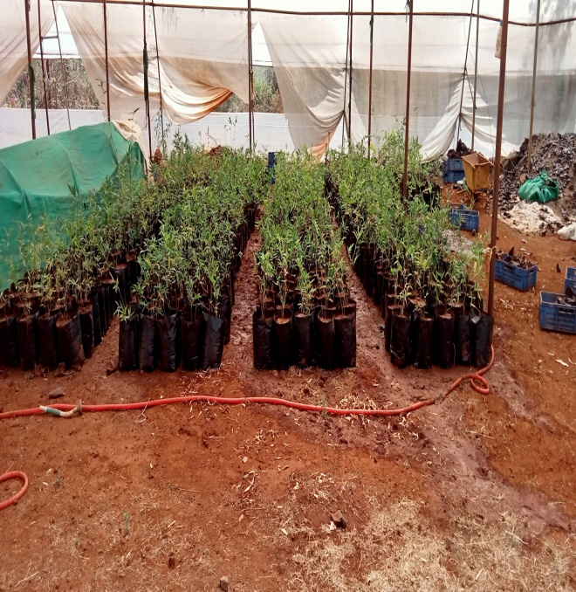
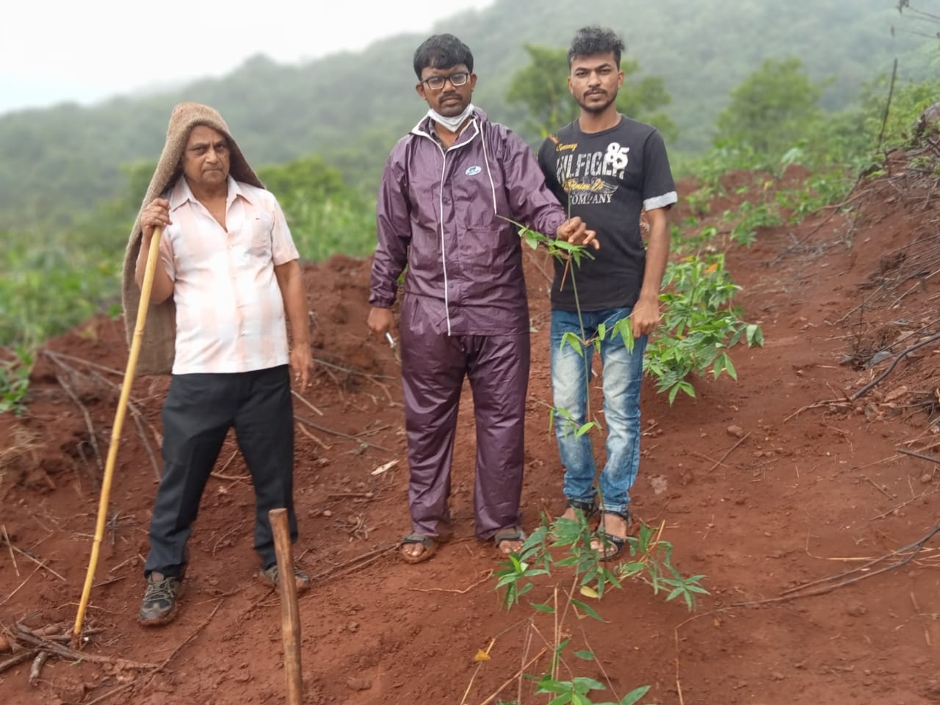
Bamboo Plantation Guidance Project 2 acre in Jaytpad Tal-Bhor Dist-Pune

Slide 17
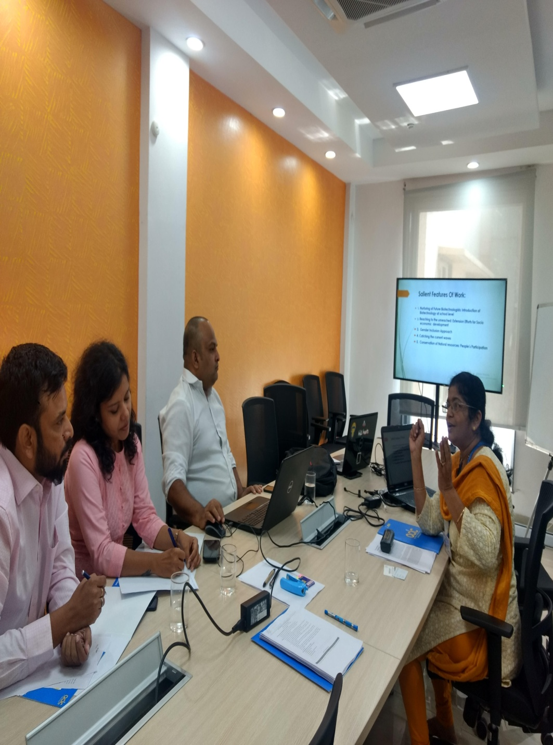
NITI Aayog PTC Training Module Presentation at NITI Aayog

Slide 18
Biotechnology Social Development Award -2017

