Slide 1
Mr.Jeet Singh IFS PCC Officer Pune Visit

Slide 2
Training in Hardening

Slide 3
Introduction of Plants Tissue Culture

Slide 4
Late Mr.Ponkashe Sir Visit

Slide 5
Culture Transfer Training

Slide 6
Culture Transfer Work

Slide 7
Culture Developed by Students

Slide 8
Mr.Nitin Kariyaji Visit

Slide 9
Exposer Visit to Commercial Hardening Unit

Slide 10
Director, of Jnana Prabodhini Mr.Girishrao Bapat Visit to Biotechnology Department

Slide 11
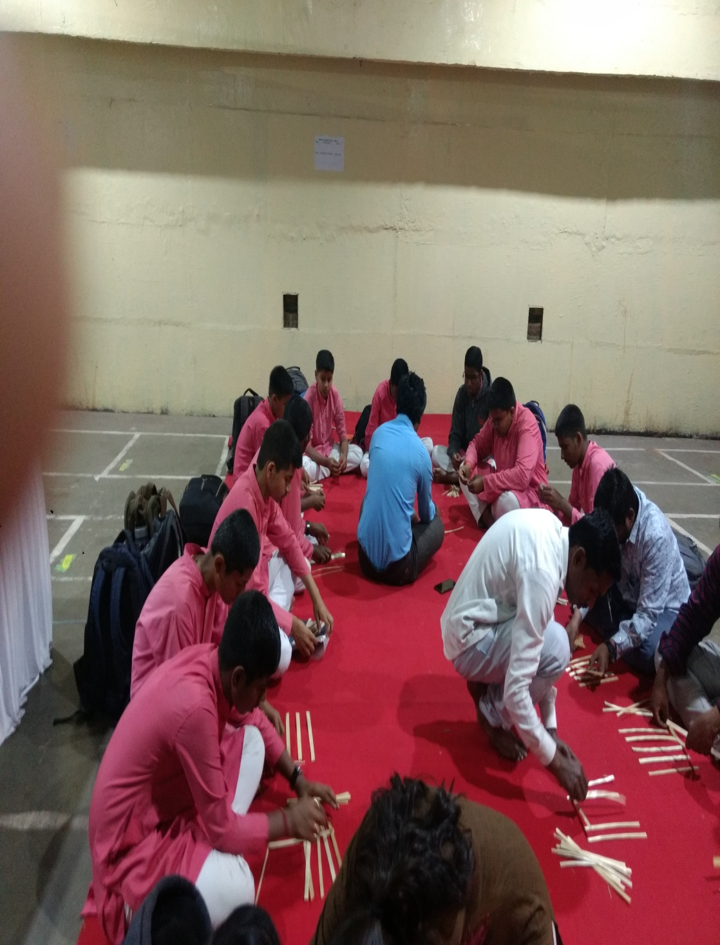
Hands on Training in Bamboo Craft of Bamboo Society of India Exhibition

Slide 12
Prize Distribution Programme

Slide 13
Dr.Rajani Nadgauda Visit

Slide 14
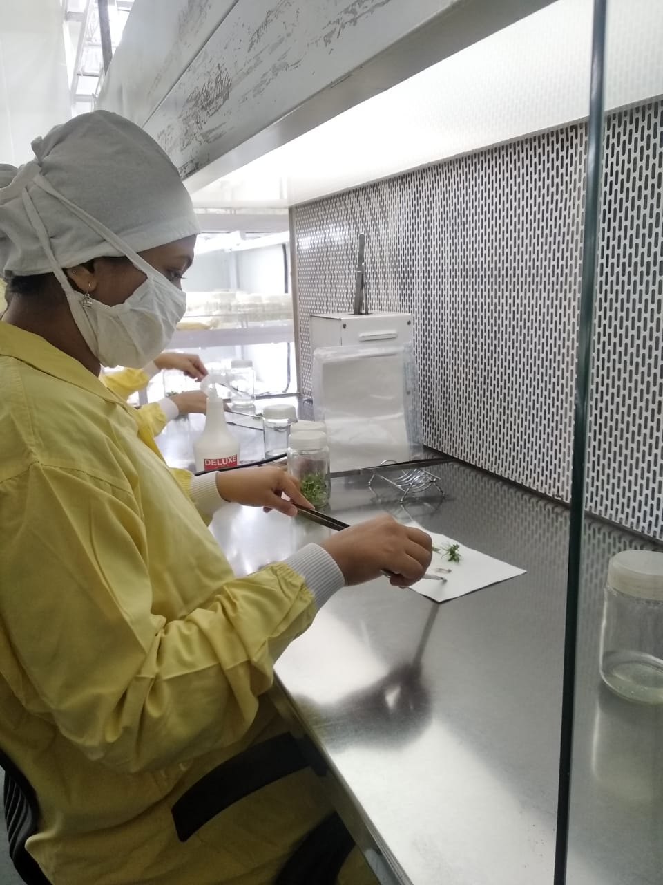
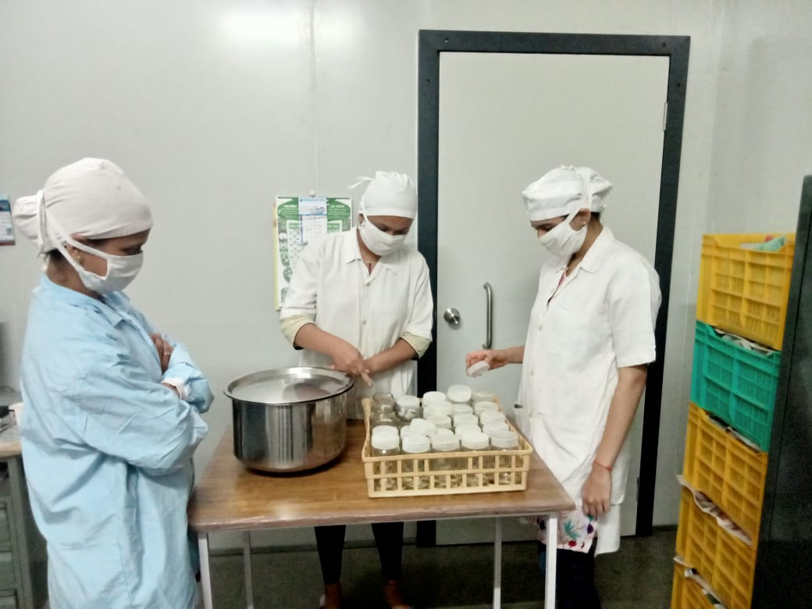
Internship Programme

Slide 15
Trainers Training in Plant Tissue Culture Professor Shantanu Kelkar, Faculty at Rizavi College of Engineering

